Slide 1
The Effect of Film Development on Primary Breakup in a Prefilming Airblast Atomiser
Jack R. J. Wetherell
Dept. of Aeronautical and Automotive Engineering Loughborough University
Andrew Garmory
Dept. of Aeronautical and Automotive Engineering Loughborough University

Slide 2
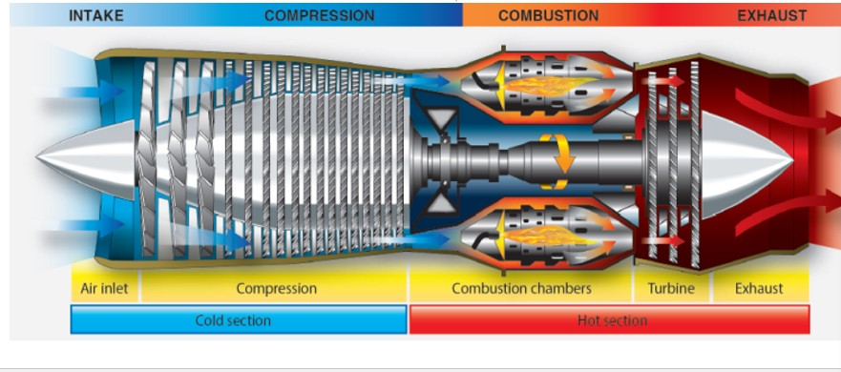
1. Introduction
Gas turbine engine

Slide 3
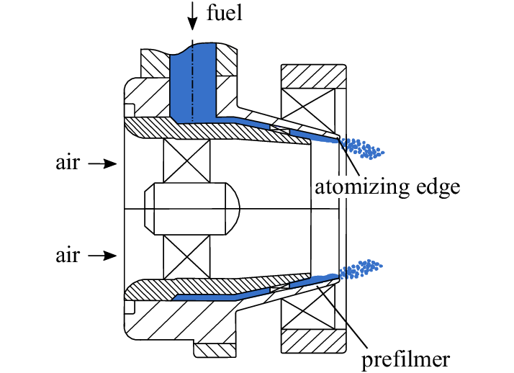
1. Introduction
Prefilming airblast atomizer

Slide 4
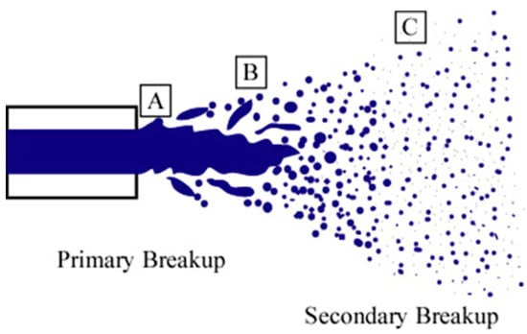
1. Introduction
Breakup process
Primary breakup occurs when the liquid is sprayed from the nozzle, representing the first breakdown stage. The liquid is separated from large droplets into smaller ones due to pressure or the force of gas (e.g., high-speed air). In this stage, the liquid typically breaks into larger drops, and the liquid's flow is distorted or torn apart by the airflow.
Secondary breakup happens after the primary breakup, where the smaller droplets are further broken down into even smaller drops due to additional forces. This stage usually involves the droplets interacting with air continuously, causing them to become finer particles. This process is influenced by the airflow, speed, and the size of the droplets.

Slide 5
1. Introduction
This paper discusses the role of atomization in liquid-fuelled combustion systems, particularly in aviation gas turbines using Sustainable Aviation Fuels (SAFs).
Prefilming airblast atomizers, often used in fuel spray nozzles, atomize fuel into droplets, but their complex geometry complicates experimental and numerical studies.
Simplified geometries, such as planar prefilmers, are often used to isolate the atomization process, allowing for the study of air-fuel interactions.
Previous simulations often model only a small part of the prefilmer due to computational limitations, missing the full effects of air and film interactions.
This paper presents a method to simulate both the film development and atomization process by splitting the simulations into two regions.
The aim is to quantify how air-film interactions over the prefilmer impact the atomization process, which is essential for improving breakup models and combustion system designs.

Slide 6
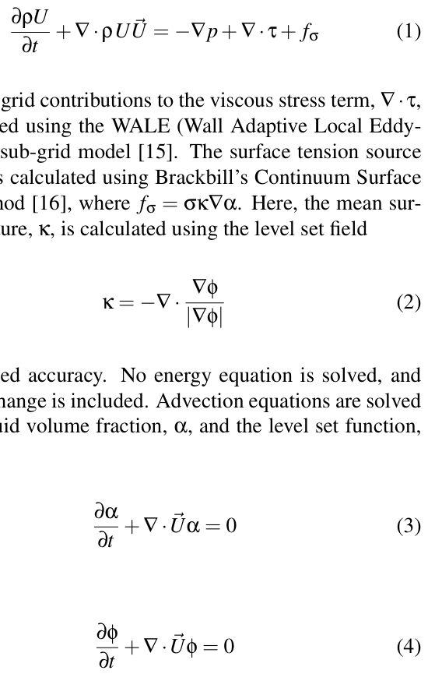

2. Numerical Method
2.1 CLSVOF(Coupled Level Set & Volume of Fluid) Solver
A single set of momentum equations
Surface curvature
Advection equations(liquid volume fraction α, & the level set function)
$$fσ​=σκ∇α$$

Slide 7
2. Numerical Method
2.1 CLSVOF(Coupled Level Set & Volume of Fluid) Solver
Interface reconstruction algorithm
To improve the accuracy of volume fraction advection, geometric discretization methods and the interface reconstruction algorithm are used.
This algorithm approximates the interface as a plane, ensuring that the cut volumes match the liquid volume fraction.
The gradient of the level set field is used to more accurately set the orientation of the interface, and the level set function is reinitialized at each timestep.
High resolution and small timesteps are required for accurate tracking of the interface, and Adaptive Mesh Refinement (AMR) is used to reduce computational cost.
AMR refines the mesh around the interface to better capture the interaction of the two phases, with refinement using Open FOAM’s octree-like strategy.

Slide 8
2. Numerical Method
Boundary Condition Reconstruction
Film development process
Atomization process
Purpose: to include the effects of the film development on the atomization
Film development simulation ⇒ the velocity, volume fraction and level set fields ⇒ Atomization simulation(inlet boundary condition)
target energy content
POD: 95%
Fourier series: 90%

Slide 9
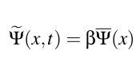
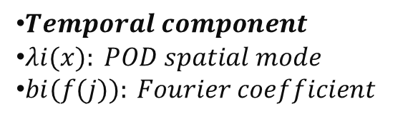
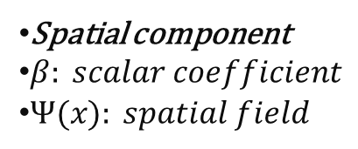
2. Numerical Method
2.2 Proper Orthogonal Decomposition & Fourier Series (PODFS)
Snapshot POD method
Advantage of Fourier series
This eliminates any need for temporal interpolation if the donor and recipient simulations have different timesteps.
Allows the input data to be repeated if the desired simulated time of the recipient simulation is longer than the donor simulation.
POD
A series of temporally-invariant spatial modes
Spatially-invariant temporal modes
Fourier series
A set of planar data(raw data)
Spatial component
$β: scalar coefficient$
$Ψ​(x): spatial field$
$Temporal component$
$λi(x): POD spatial mode$
$bi(f(j)): Fourier coefficient$

Slide 10
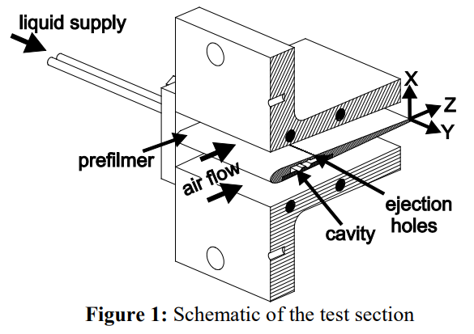
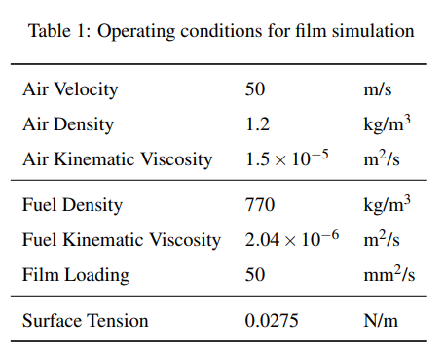
3. Film Development Simulation
A block-structured hexahedral mesh is used, with grading at the walls to ensure a y + of below one (∆y = 5µm), and a isotropic freestream resolution of 100 microns.
The total cell count is 74.7 million cells.
A fixed, uniform velocity is applied to both the air and fuel inlets with no turbulent fluctuations.
No atomization is included in this simulation as the outlets are placed parallel with the prefilmer trailing edge.
A fixed contact angle of 8.65° is applied to the prefilmer surface
A timestep of 0.4µs is used to give a maximum CFL number of 0.7. The film is initialized dry, and 120ms of simulated time is required for the film to fully develop and cover the wetted surface.
Once the simulation has fully developed, a further 50ms of simulated time is used to extract data for the atomization simulation boundary conditions.
The simulations were run using 1,280 cores on Sulis at HPC Midlands+, for a total cost of 990,000 CPU hours.

Slide 11
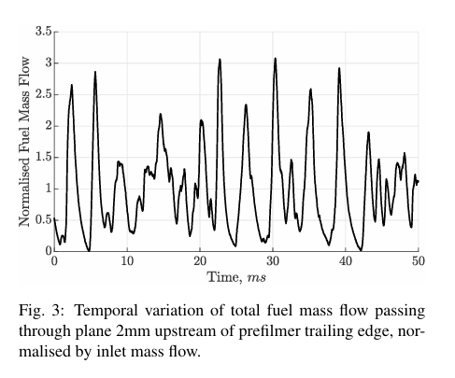
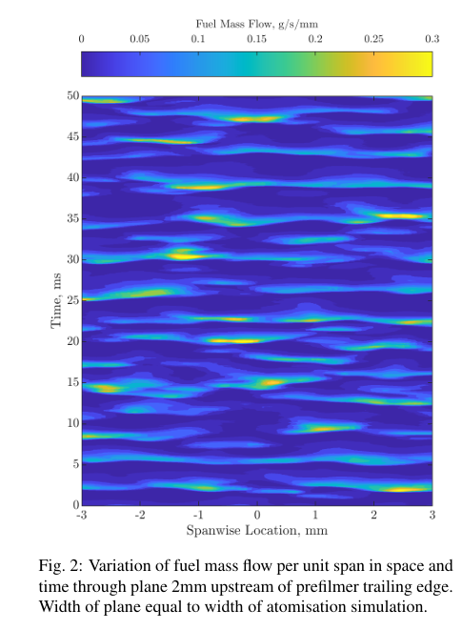
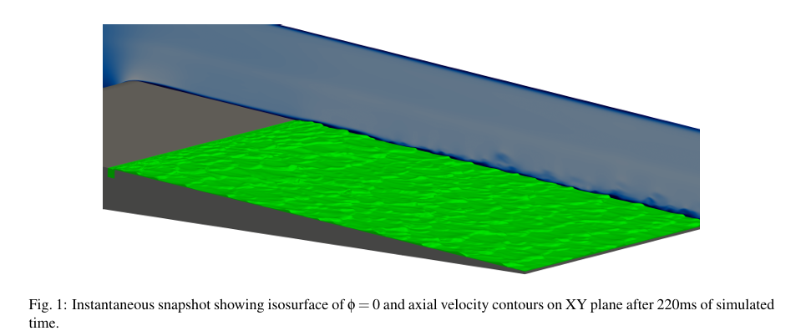
3. Film Development Simulation
3.1 Film Overview
Notes:
그림 1은 시뮬레이션이 완전히 개발 단계에 도달했을 때의 필름과 공기의 상태를 보여줍니다.

Slide 12
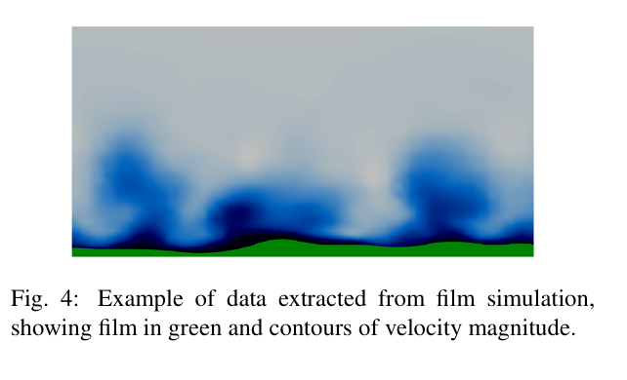
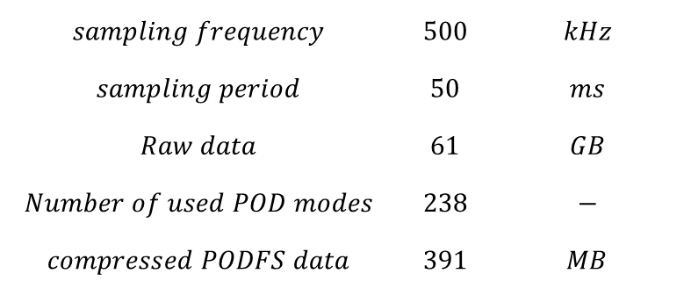
3. Film Development Simulation
3.2 Extracted Boundary Conditions
The three velocity components, liquid volume fraction, and level set fields are extracted on a plane 2mm upstream of the trailing edge
$$sampling frequency$$ | $$500$$ | $$kHz$$
$$sampling period$$ | $$50$$ | $$ms$$
$$Raw data$$ | $$61$$ | $$GB$$
$$Number of used POD modes$$ | $$238$$ | $$−$$
$$compressed PODFS data$$ | $$391$$ | $$MB$$

Slide 13
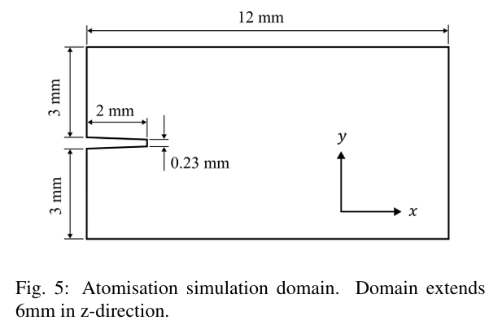
4. Atomization Simulation
The base mesh resolution is 50µm, with three levels of AMR applied for an interface resolution of 6.25µm, reducing the total cell count to 10-20 million compared to 1.9 billion in a static mesh.
Velocity, liquid volume fraction, and level set fields are reconstructed at the inlet planes above and below the prefilmer, with a no-slip wall surface and a fixed static contact angle.
OpenFOAM’s inlet & outlet boundary condition is used for inflow and outflow, with pressure fixed at the outlet.
The simulation uses a 50ns timestep to maintain a maximum CFL of 0.7 and was run for 30ms, including 10ms for development and 20ms for sampling.
The simulation utilized 512 cores and required 950,000 CPU hours.

Slide 14
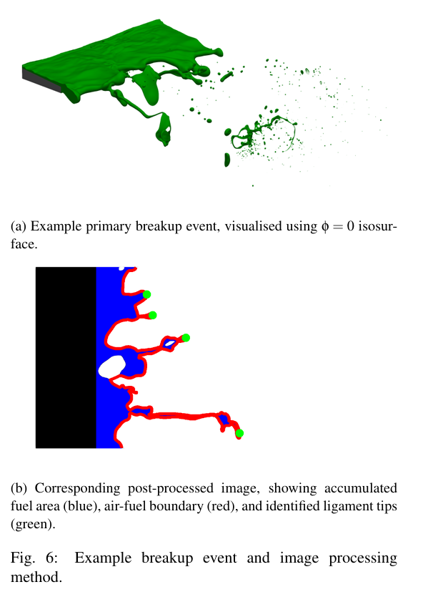
4. Atomization Simulation
4.1 Accumulation and Ligament Formation

Slide 15
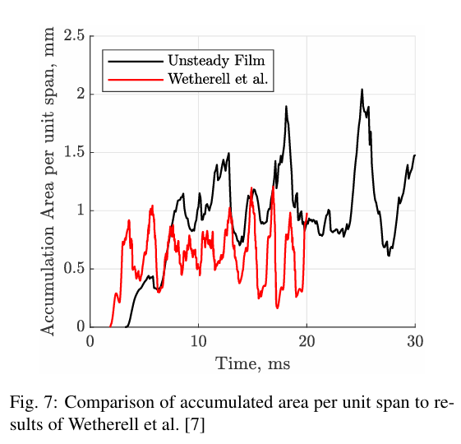
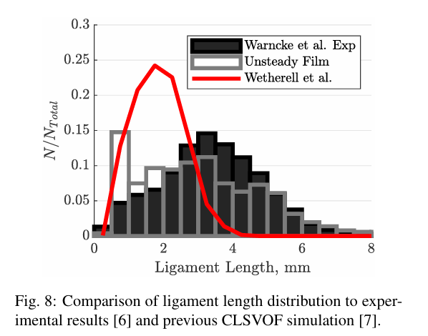
4. Atomization Simulation
4.1 Accumulation and Ligament Formation

Slide 16
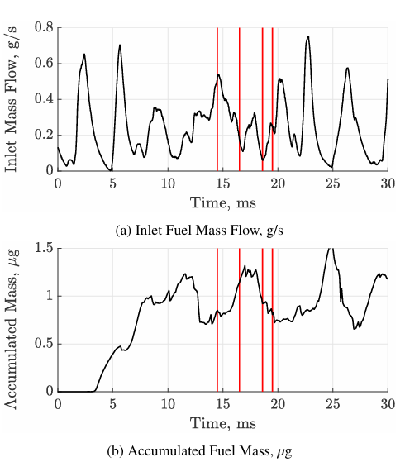
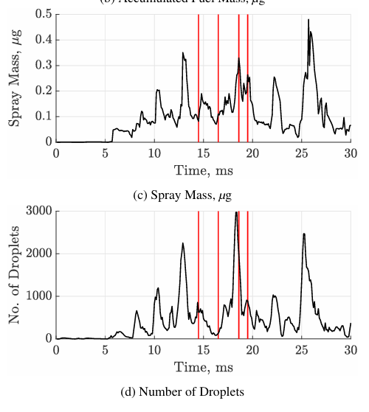
4. Atomization Simulation
4.2 Film-Spray Coupling
The accumulated mass is calculated by summing ρUα in all cells downstream of the prefilmer trailing edge that are connected to the bulk fuel reservoir.
Droplets are identified using a CCL (Connected Component Labelling) algorithm, which measures the position, velocity and volume of each droplet.
A representative diameter is calculated assuming the droplet is spherical.

Slide 17
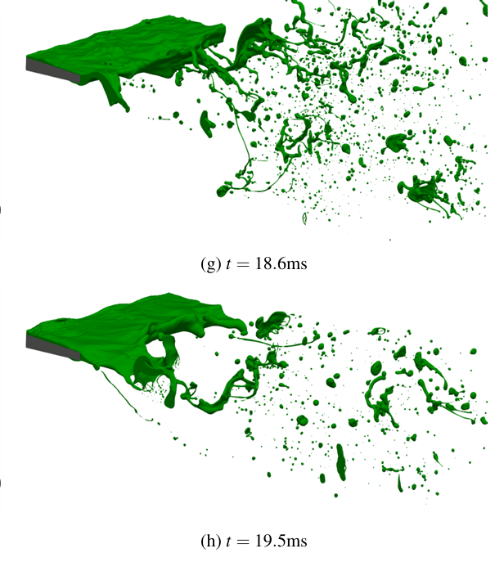
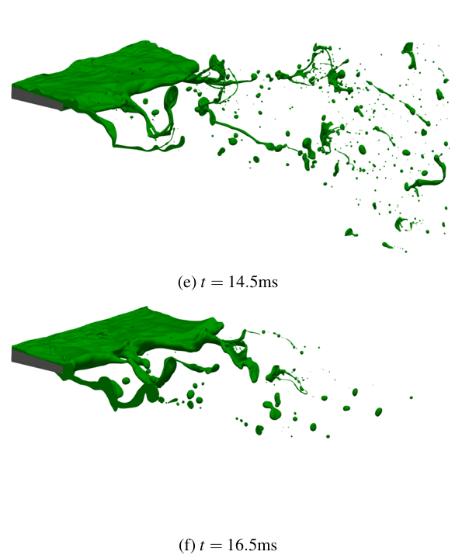
4. Atomization Simulation
4.2 Film-Spray Coupling

Slide 18
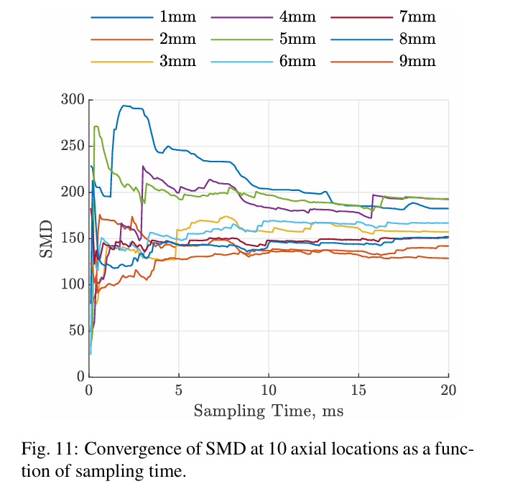
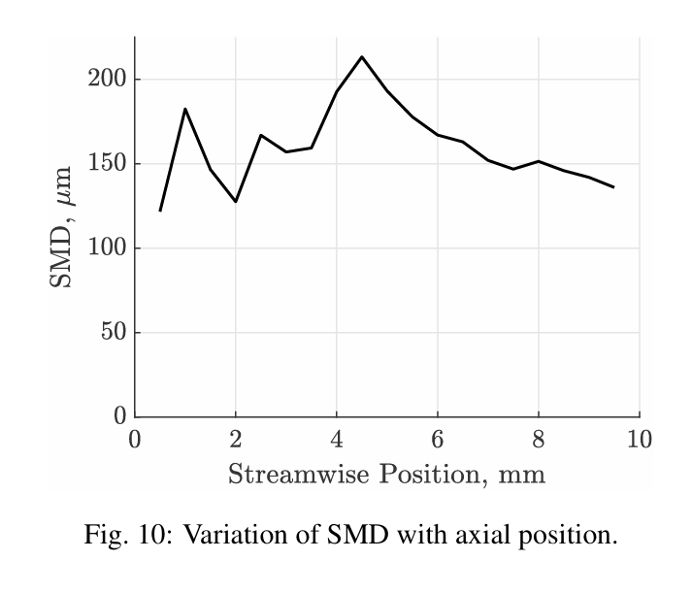
4. Atomization Simulation
4.2 Spray Statistics

Slide 19
4. Atomization Simulation
4.3 Statistical Convergence in Atomization Simulations
Temporal Variability of the Unsteady Film and Atomization
The atomization process is inherently stochastic, and extracting statistical data requires averaging over numerous atomization events.
The properties of the film's trailing edge vary in both space and time, directly influencing the atomization process.
The variability of the film lacks a fixed period, wavelength, or amplitude, necessitating a significantly larger number of events to achieve converged statistics.
Challenges in Obtaining Independent Samples
The timescale of atomization events is on the order of milliseconds, requiring sufficient time intervals to ensure that the same droplet or ligament structure is not measured twice.
In simulations, the short sampling period and high computational cost (40,000 CPU hours per millisecond) make it impractical to achieve converged statistics, as this would require an unfeasibly high computational expense (millions to tens of millions of CPU hours).

Slide 20
5. Conclusions
The reduced interface shear due to the air-film development over the prefilmer results in increased accumulation of fuel behind the trailing edge, and a shift in the ligament length distribution, with longer ligaments being produced and better agreement with experimental distribution.
The SMD is significantly increased, and better agreement between simulation and experiment is now achieved.
A clear correlation in time and space between the unsteadiness in the film and the spray can be seen, due to the interaction of the additional mass and momentum within the waves with the fuel reservoir.
The unsteady film and stochastic atomization process mean that the required sampling times for fully con verged statistics are unfeasible due to computational cost requirements, and care should be taken when com paring size distributions to experiment as a way of vali dating a simulation.

